Slide 1

Seminar
On
Student Information Chatbot System
Team Members:
Kajal Gupta
Tushar Kumar
Paras Jain
Radhika Sharma
Project Guide :
Ms. Dhara Upadhyay

Slide 2

A Project Based On Artificial Intelligence

Slide 3
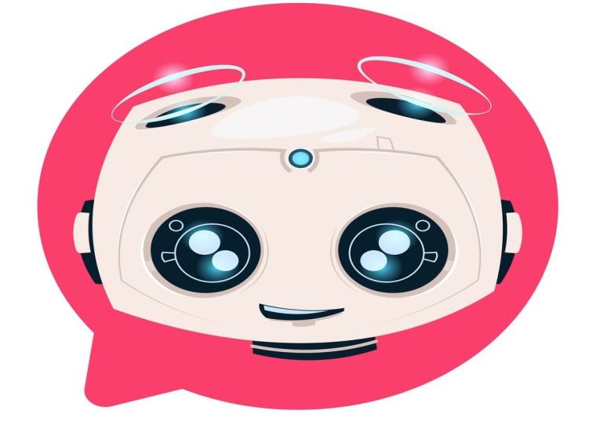
Student Information Chatbot System
Meet with our Stufo ;-)

Slide 4
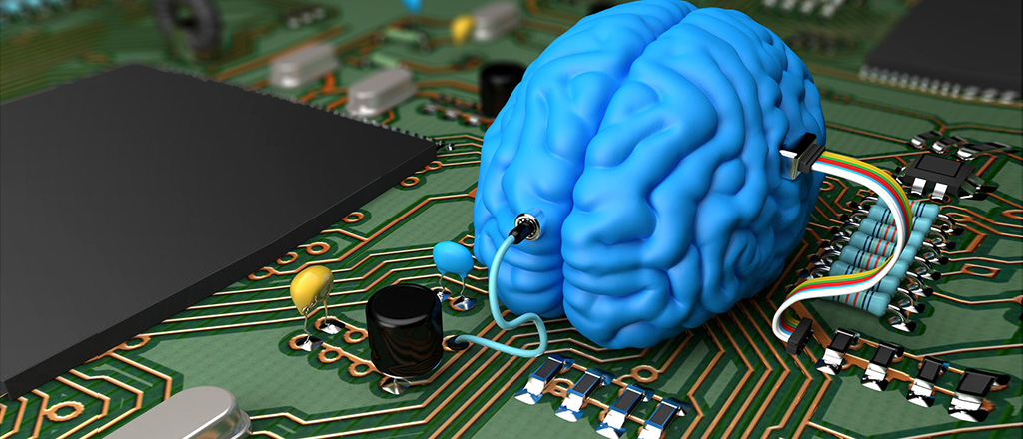
What is AI?
Artificial intelligence (AI) refers to the simulation of human intelligence in machines that are programmed to think like humans and mimic their actions..
AI - Providing a Brain to computers or Machines….

Slide 5
Understand ChatBot
A chatbot also known as a chatterbot, bot, artificial agent, etc. is basically software program driven by artificial intelligence which serves the purpose of making a conversation with the user by texts or by speech. Famous examples include Siri, Alexa, etc.
Uses:
For Student’s query Solver.
For Making a Transaction.
Form Submission
Booking a hotel
Customer Service & many more.

Slide 6
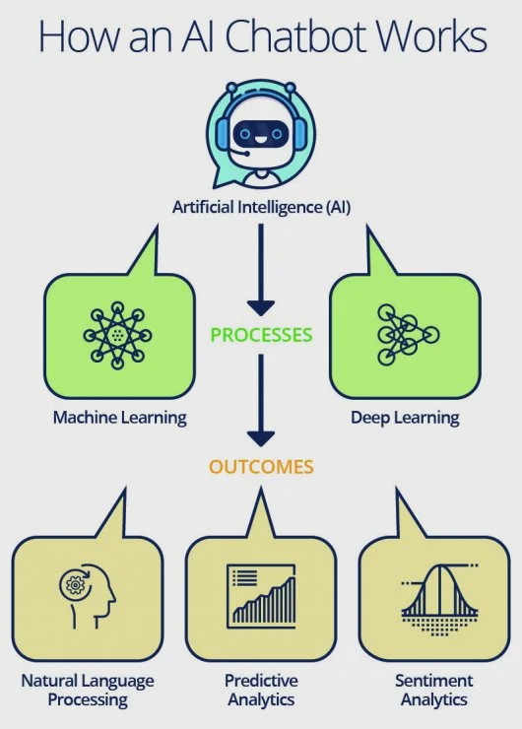
How a ChatBot Works

Slide 7
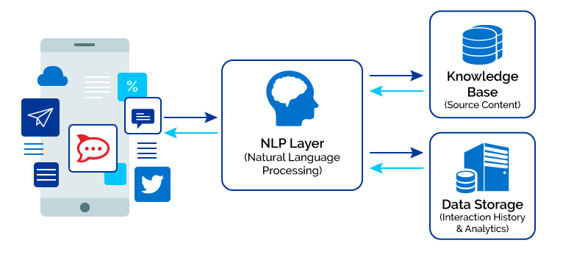

Slide 8
About Project -
Student Information ChatBot System is a AI Enabled Chatbot.
It can be used to solve various challenges or issues faced by a Educational Institute.
Features:
A GUI having Voice Based
Interface.

Slide 9
Technology Used
Technology Used:
Completely Based on Python.
Python Libraries Used:
ChatterBot
Pyttsx3
Speech Recognition
Tkinter

Slide 10
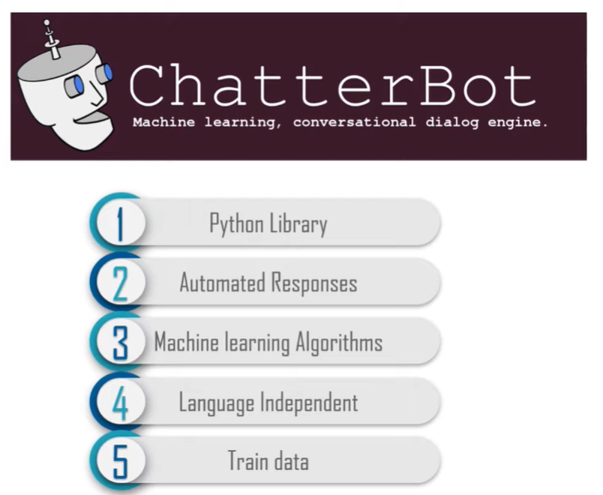
Know These Libraries
ChatterBot :

Slide 11
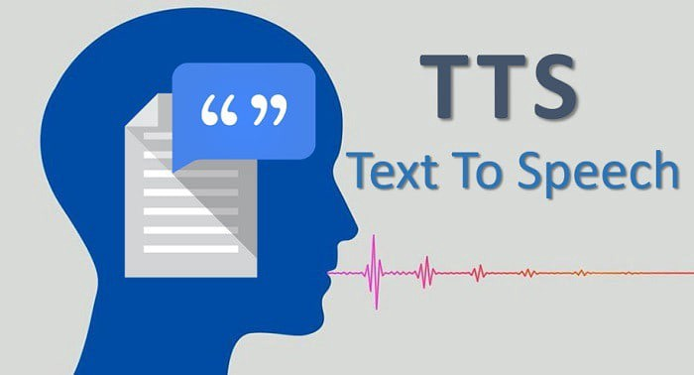
2. pyttsx3
Text-to-speech conversion library in Python
Works Offline.

Slide 12
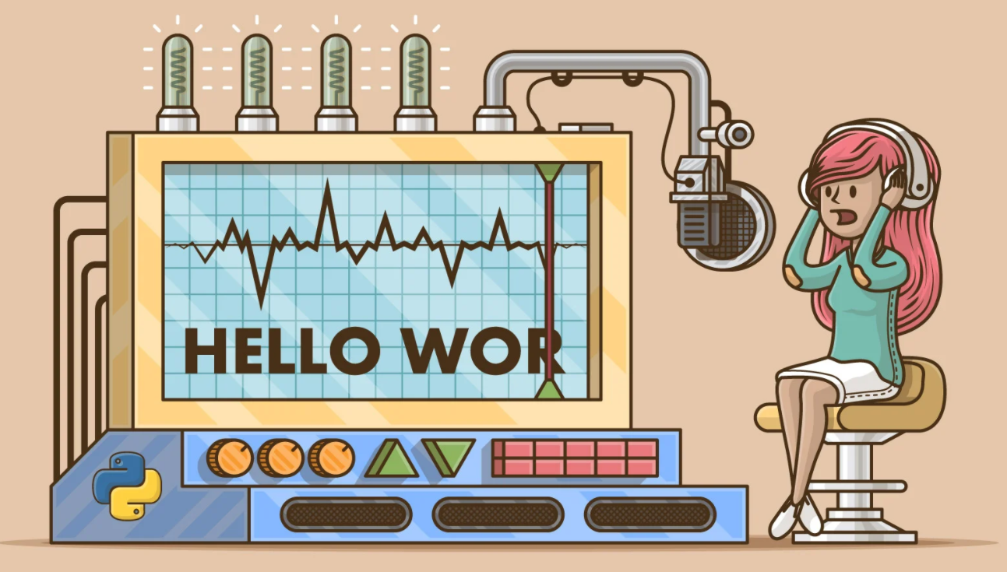
3. Speech Recoginition :
Library for performing speech recognition, with support for several engines and APIs, online and offline.

Slide 13
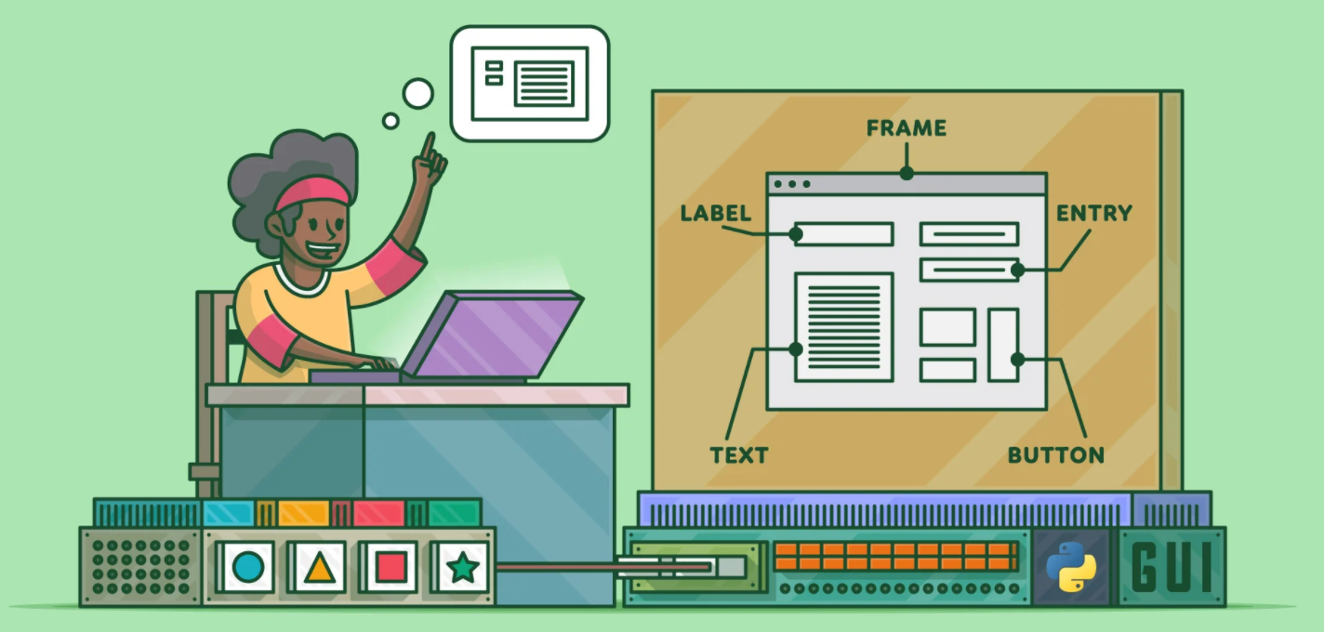
4. Tkinter
Standard GUI library in Python.
Provides a fast and easy way to create GUI applications.
Provides a powerful object-oriented interface to the Tk GUI toolkit.

Slide 14
Let’s Start With Code
#importing all the required modules
from chatterbot import ChatBot #import chatterbot library
from chatterbot.trainers import ListTrainer #to train the chatbot
from tkinter import *
import pyttsx3 as pt
import speech_recognition as s
import threading
from PIL import ImageTk,Image
#create mybot object from ChatBot Class
mybot=ChatBot("Stufo")

Slide 15
#providing conversation to chatbot so that it get trained
conversation_demo = [
'hello Stufo',
'hello dear!!',
'what is your name ?',
'My name is Stufo..',
'How are you?',
'I am good..what about you?',
'I am cool',
'That is great',
'what you do?',
'Stufo is here for your help..Do you have any query?',
'what is the last date of fees deposition?',
'It is 15 december..',
'could you please tell me more about this college?',
'Arya Group of Colleges Jaipur was established under the aegis of All India Arya Samajis Society for Higher & Technical Education in the year 1999 by the founder chairman Er. Shri T.K. Agarwal, a great visionary, from Roorkee University always believed that engineers builds Nation. In his quest for glory and pride, he established the first private Engineering College in the Rajasthan state. His vision ushered the establishment of over 150 private engineering colleges & his efforts developed the state of Rajasthan into a IT hub of North India.',
'How many faculties are there in college?',
'The faculties are very trained in their respective domain and highly skilled.There are about 100 teachers are there in college',
'when my second midterm exams start?',
'It is from next week..',
'Is, there any placement drive next month?',
'yes, amigoz company will be having there drive..',
'Thank you',
'Always Welcome',
]

Slide 16
#creating object of ListTrainer Class trainer by providing the reference of bot
trainer = ListTrainer(mybot)
#now we are training the stufobot with the help of trainer object previously created via using train variable
trainer.train(conversation_demo)
#create the window using TK class
main = Tk()
main.geometry("500x650") #give the size to main window
main.title("StufoBot ") #Give title
main.configure(bg='black') #background color set to black of window
#to put image in window
width = 130
height =130
img = Image.open("bot3.jpg")
img = img.resize((width,height), Image.ANTIALIAS) #resize the photo
photoImg = ImageTk.PhotoImage(img) #create image object using PhotoImage class
#create Label using Label class and giving it to parent window and giving image object
photo = Label(main, image=photoImg)
photo.pack(pady=5)
#crate frame giving main windows as parent window
frame = Frame(main)
#create scrollbar
sc=Scrollbar(frame)
#create listbox and give frame as parent window
#to active scrollbar using yscrollcommand property by giving set reference function
msgs=Listbox(frame, width=80, height=20, yscrollcommand=sc.set)
#now pack these all
sc.pack(side=RIGHT, fill=Y)
msgs.pack(side=LEFT, fill=BOTH, pady=10)
frame.pack()
#creating text field and put in main window using font tuple.
textF = Entry(main, font=("Verdana",12))
textF.pack(fill=X , pady=10)

Slide 17
engine = pt.init() #initilize the pyttsx3 module,it returns a pyttsx3.Engine instance store it in engine variable.
voices = engine.getProperty('voices') #returns a list
engine.setProperty('voice', voices[0].id) #here key is voice and value is id of male voice ,voices[0] will be for male.
#for speaking the word argument giving to speak function.
def speak(word):
engine.say(word)
engine.runAndWait()
#Take audio as a input from user and convert it into string..
def takeQuery():
sr=s.Recognizer() #create object sr of Recognizer class
sr.pause_threshold = 1 #oause_threshold property by using sr object
print("Stufo is listening to you...Try to speak")
#create object of Microphone class m
#Take audio via using the system's microphone
with s.Microphone() as m:
try:
audio=sr.listen(m) #use listen function of sr and pass this audio to it to listen the audio
#query variable will be having user's question
query=sr.recognize_google(audio,language='eng-in') #convert your audio or speech into text
#clear the textfiled
textF.delete(0,END)
#insert the data in textfield also whatever user asking
textF.insert(0,query)
#now call the function to take response as input
ask_from_bot()
except Exception as e:
print(e)
print("Not Recognized")

Slide 18
#give now above generated query to this function
def ask_from_bot():
query=textF.get() #taking quering from textfield
answer_from_bot = mybot.get_response(query) #take response from bot using get_response
#insert in the msgs in GUI part your query
msgs.insert(END,"You : "+query)
#insert the the response of bot
msgs.insert(END, "Stufo : "+str(answer_from_bot))
#now speak the response of bot
speak(answer_from_bot)
#delete the text in textfield
textF.delete(0,END)
#to end y view means if the text till ends it will go the till end
msgs.yview(END)
#create Button and call the funtion ask_from_bot from this function.
btn = Button(main, text="Ask from Stufo", font=("Verdana",12) , command=ask_from_bot)
btn.pack()
#creating a function to press the ask button via program,
def enter_function(event):
btn.invoke()
#going to bind main window with enter key...means if we enter the function will be call
#we are giving funtion reference here only
main.bind('<Return>', enter_function)
def repeatlisten():
while True:
takeQuery()
# create a thread and giving function reference in target
#To handle the audio
t = threading.Thread(target=repeatlisten)
#start the thread
t.start()
main.mainloop()

Slide 19
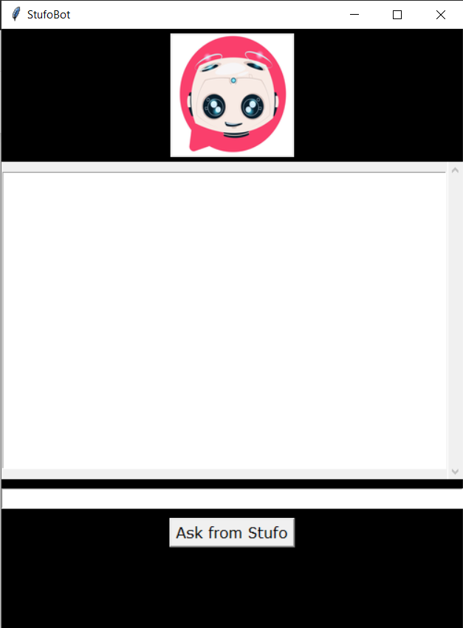
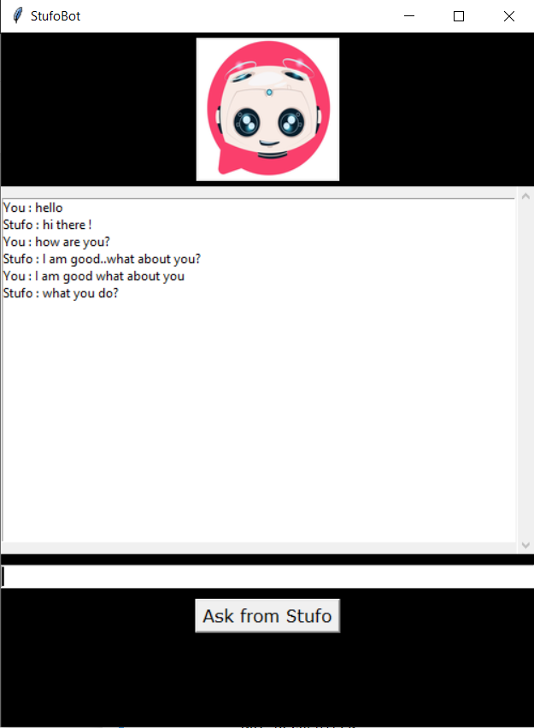
Stufo is Ready…

Slide 20
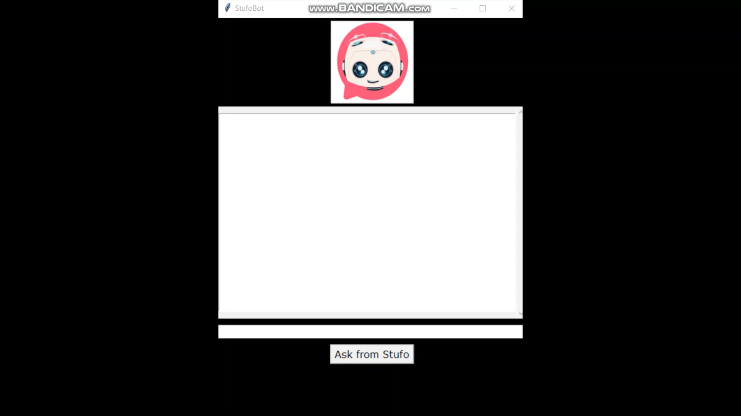

Slide 21
Conclusion..
Chat Bots are Highly Demanded Products of AI..
The customers and Clients are very Huge.
Provides Great Management in Educational Institutes, Medical Centers, Enhancing Customer Services .
Reduce Work Load etc.
https://github.com/Radhika299/Stufobot

Slide 22
Thank You..
Any Query??

